Slide 1

Blood Examination
Practical Parasitology
3rd Class
Prof. Dr. Muna M. Jori

Slide 2
Introduction
Examination for parasites should always be performed and examination for many samples, like, feaces, blood, urine, nasopharyngeal, genital tract. Blood examination used to identify blood parasites which may intracellular or extracellular and mostly protozoa, each animals with special site of blood collection which different from one to another as it’s below:

Slide 3
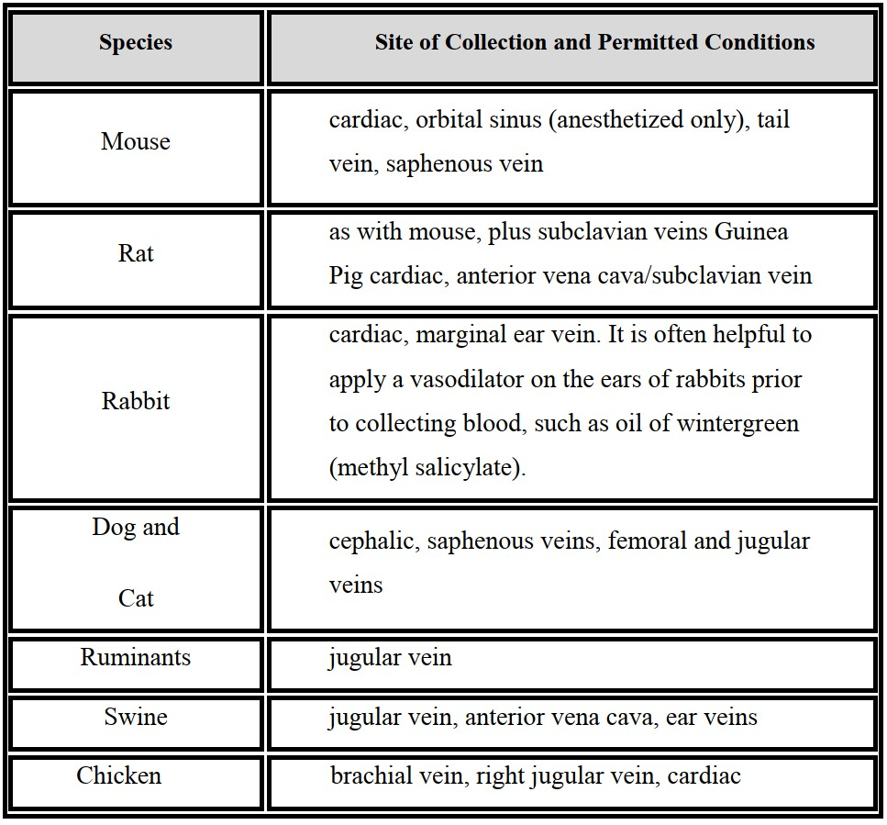
Table (1): sites of blood collection from different species

Slide 4
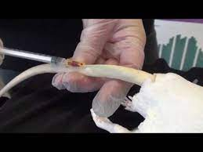
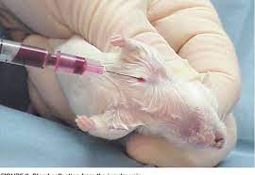
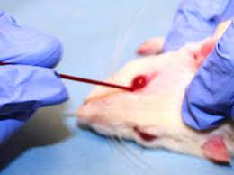
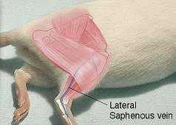
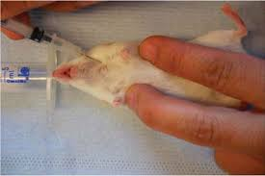

Slide 5
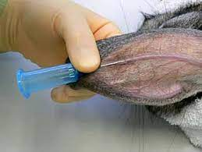
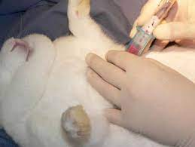
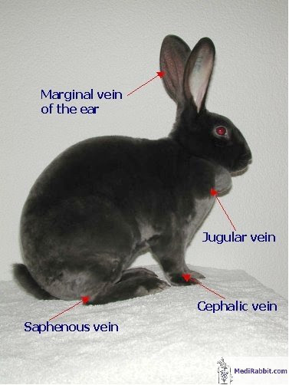
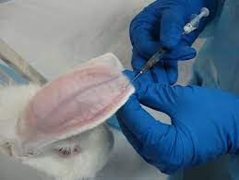

Slide 6
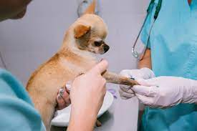
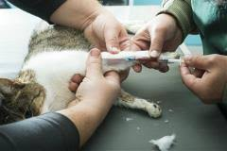
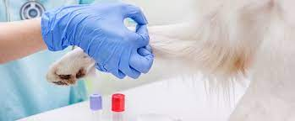
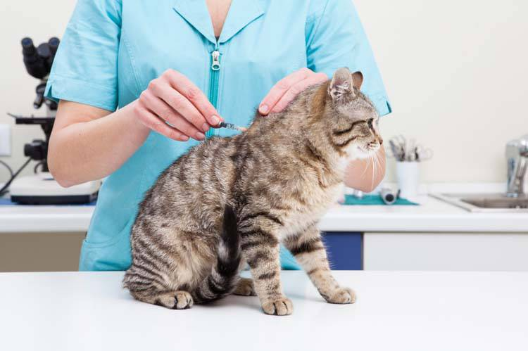
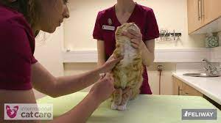
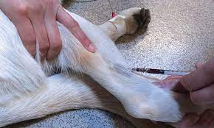

Slide 7
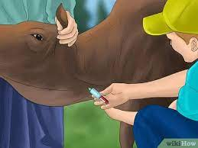
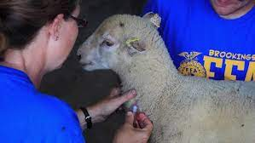
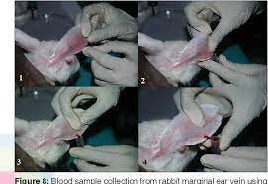
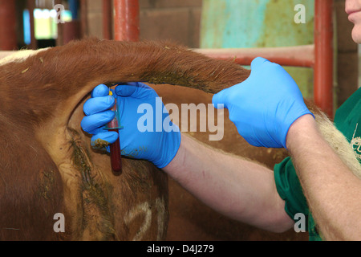

Slide 8
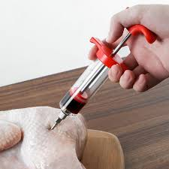
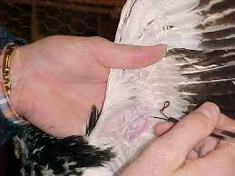
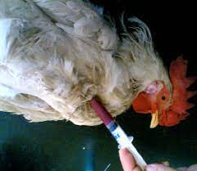
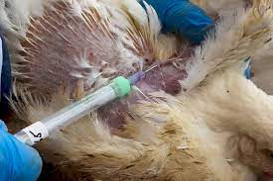
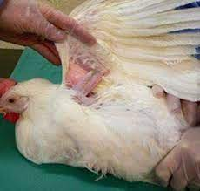
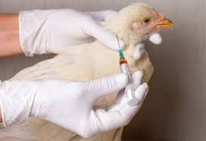
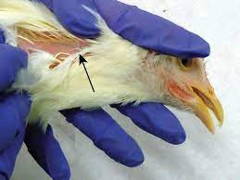
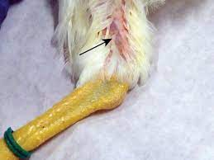

Slide 9
Generally, there are two ways to performed blood smear:
A. Direct Examination:
1. Place three drops of fresh blood, mixed with anticoagulant
(EDTA) on a clean slide.
2. Put a cover slip over it and examine under microscope.
3. The live trypanosomes and microfilaria are identified in the
basis of their characteristic shape and motility.
B. Staining Blood Smear:
1. Preparation of Blood Smear: There are two kinds of blood smears:
A. Thin Blood Film:
place a new clean glass slide (specimen slide) on a flat surface and add a small drop of blood from the end of the slide.
while holding the other end of the specimen slide in place with the finger of one hand,
another slide (spread slide) is placed in front of the drop of blood with the other hand. The spreader slide should be held as follows:

Slide 10
I. The middle finger should be below the spreader slide while the slide is stabilized by the edges of the adjoining fingers.
II. The spreader slide should be held at a 45-degree angle and slowly drawn backward into the drop of blood.
III. Once the edge of the spreader slide is in contact with the blood, the angle of the slide is lowered to about 25 degree to allow the blood to flow evenly across the edge of the spreader slide.
IV. Once the blood has spread evenly across the edge of the spreader slide , quickly pushed the slide across the entire length of the slide containing the blood.
V. As the spreader moves, a thin film of blood will be left on the specimen slide. ideally the blood smear should cover 2/3 to 3/4 of the slide when correctly prepared. the goal is to achieve a wedge-shaped smear with a thin edge.
VI. The blood smears should be air-dried. they should be labeled immediately with patient's name and date.

Slide 11
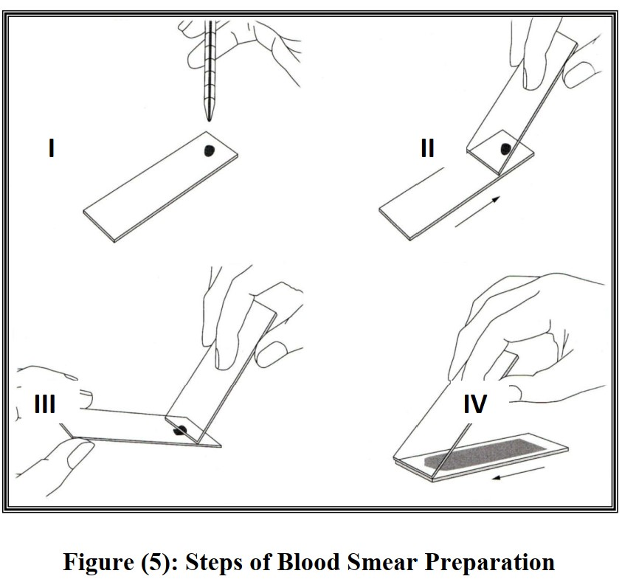

Slide 12


Slide 13
B. Thick blood film:
Thick blood films are prepared to identified nematode microfilaria. these are soaked in water or in aqueous solution of stain (Giemsa) to leach out the hemoglobin out of the red cells. if the stain is alcoholic stain (Leishman) the films are immersed in water and
agitated gently until colorless, the films are dried in air before staining.
2. Staining:
a. Giemsa Stain:
I. Preparation of Stain :
Giemsa stain 0.75 gm , Glycerol 25 ml . Methanol 75ml
For preparation, the stain is placed in a mortar glycerol is added to make a paste with pestle. Then methanol is added and stirred for mixing. Finally, stain is poured into a dark bottle and incubated at 37 C for 24 h. (Giemsa working solution prepared by adding 1 part of Giemsa stain solution to 10 parts of buffered water (pH= 7.2).

Slide 14
II. Procedure
1- Fixed the air dried film with methanol for 2 minutes.
2- Allow the smear to dry and then immerse it in Giemsa working solution for 45 min.
3- Discard the excess stain and rinse the slide in buffered water.
4- Drain the slide thoroughly in vertical position and allow them to air dry.
5- Wipe the bottom sides of the slide before drying.
6- Mount the stained smear in a neutral mounting median (Canada balsam or DPX).
b. Leishman Stain:
I. Preparation of Stain:
Leishman stain 150 gm, Methanol (pure) 100 ml
For preparation, the stain and methanol are added into a dark bottle. the stain dissolve slowly and the bottle should be shaken from time to time during next two days.

Slide 15
II. Procedure
1-Cover the air-dried blood smear with 7-10 drops of stain.
2-Dilute the stain solution with twice the number of buffered water drops (pH=6.5) after one minute.
3-Commleave it for 15-20 min. and then drain off the excess stain.
4- Rinse the stained slide with buffered water and keep it vertically for air-drying.
Note:
There are also other stains to stain the blood films such as Wright's stain and Field's stain.

Slide 16
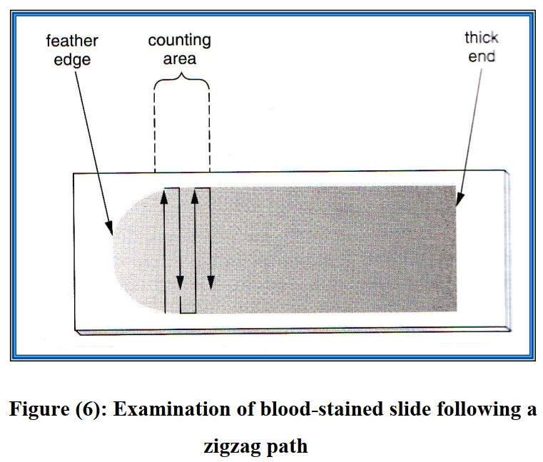
Examination of Blood-Stained Slide
The blood smear is first viewed under low power to find an area for viewing that is, an area where the cells are not overlapping but are in only one layer close to one another. this area is usually located near the wedge-shaped end of the blood smear. A drop of immersion oil is then placed on the selected site and the 100X lens is moved into the oil while observing from the side. the smears should be examined following a zigzag path as shown in (fig. 2). Moving toward the thicker part of the smear.

Slide 17

GOOD LUCK

